Slide 1

A Brief Introduction of Multiple Object Tracking
赵梓豪 2019.2.28

Slide 2
Outline
Statement of the logical architecture and main points
Overview about MOT
MOT Categorization
MOT Component
MOT Evaluation
State-of-the-art Works

Slide 3

1
Overview

Slide 4
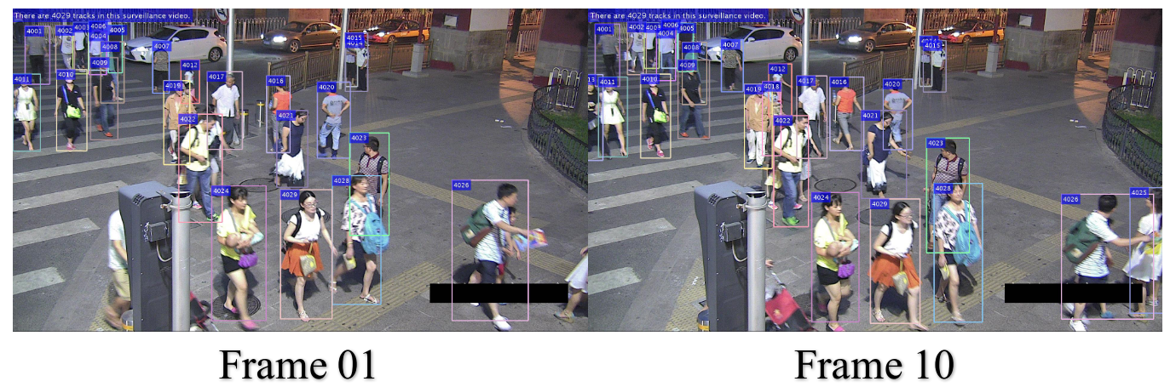
1.1 What is MOT?
Multi-object tracking (MOT) is to locate each target at each frame, and draw their trajectories.
The class of targets can be pedestrians, cars, faces etc.
Pedestrian MOT is one of the most difficult MOT task, because pedestrian is non-rigid body.

Slide 5
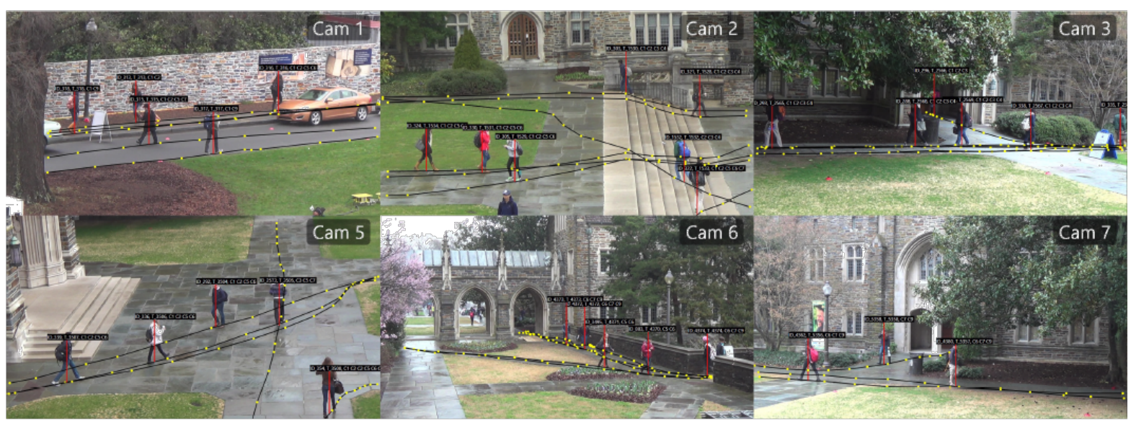
1.2 Application
Application of Multi-object Tracking (MOT)
Intelligent monitoring and security
Automated Driving System
Medical Use

Slide 6
1.3 Problem Formulation
Multiple Object Tracking
Input: Video sequence(Initial bounding box)
Output: The trajectory and a unique ID for each target. Each target is represented by a bounding box.

Slide 7
1.4 Terminology
Tracklet
Trajectory

Slide 8
2
MOT Categorization

Slide 9
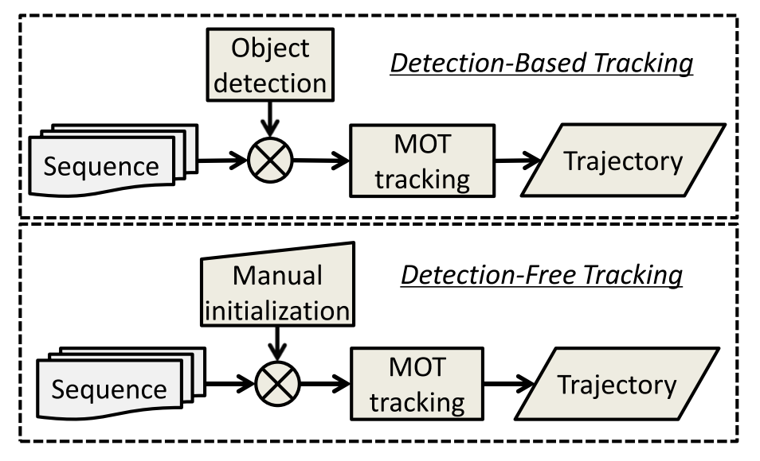
2.0 MOT Categorization
Model-free Method
Tracking-by-Detection Method
Offline Learning
Online Learning
Near-online Learning

Slide 10
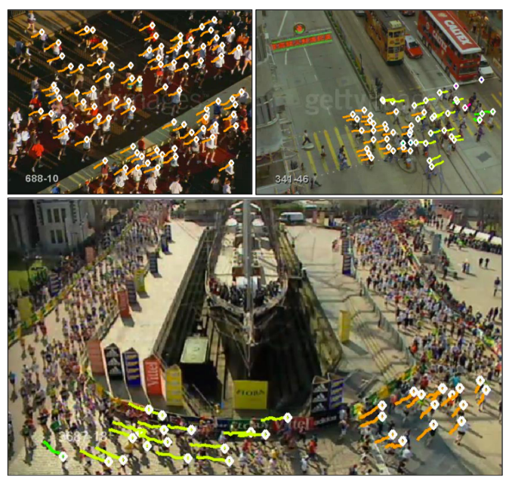
2.1 Model-free Method
Main idea: Given detections from the first frame, track these detections in the whole sequence.

Slide 11
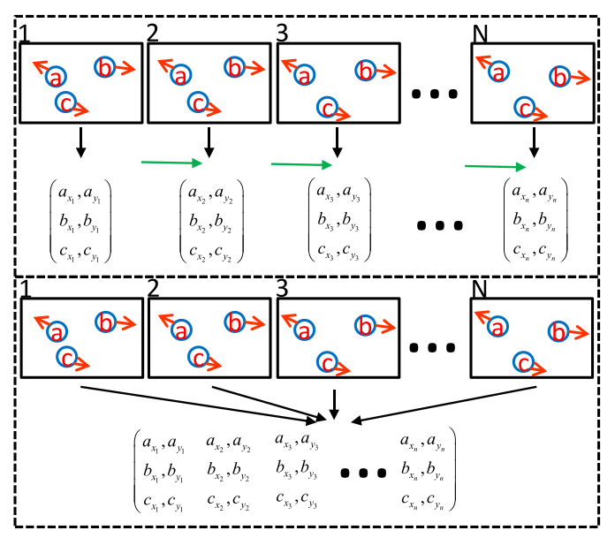
2.2 Tracking-by-Detection Method
Offline Learning
Online Learning
Near-online Learning

Slide 12
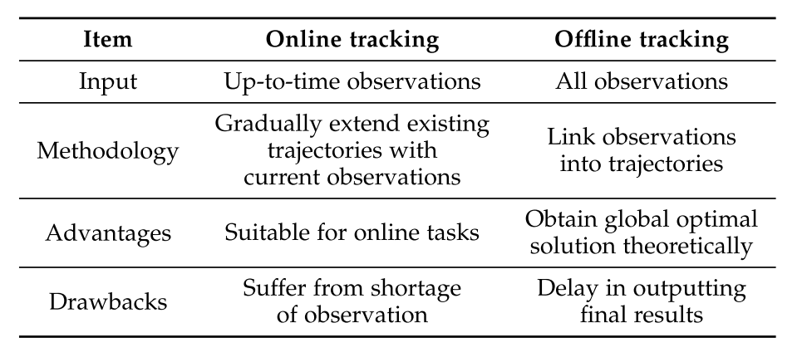
2.2 Tracking-by-Detection Method

Slide 13
2.2.1 Offline Learning
Main idea: Utilize the detections from all frames through the entire sequence, followed by a global optimization.
Iteration Method
Main idea: generate tracklets as input, and merge short tracklets into long trajectories iteratively.
Graph Optimization
Main idea: Construct a graph for the objective function optimization.

Slide 14
2.2.2 Online Learning
Main idea: Utilize the detections from the current frame and associate them with trajectories in previous frames.

Slide 15
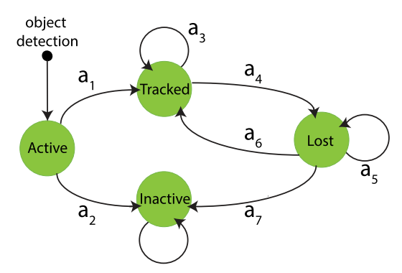
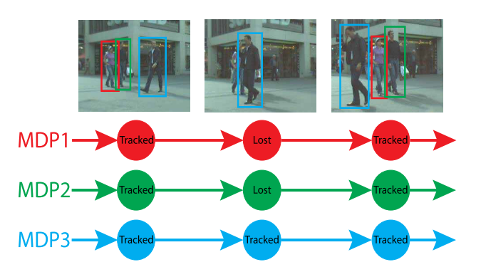
2.2.2 Online Learning
Xiang, Y., Alahi, A., & Savarese, S. (2015). Learning to Track: Online Multi-object Tracking by Decision Making. In 2015 IEEE International Conference on Computer Vision (ICCV) (pp. 4705–4713). IEEE. https://doi.org/10.1109/ICCV.2015.534

Slide 16
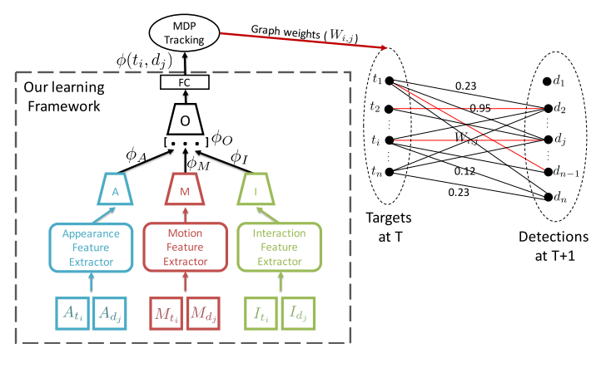
2.2.2 Online Learning
Sadeghian, A., Alahi, A., & Savarese, S. (2017). Tracking the Untrackable: Learning to Track Multiple Cues with Long-Term Dependencies. Proceedings of the IEEE International Conference on Computer Vision, 2017–Octob, 300–311. https://doi.org/10.1109/ICCV.2017.41

Slide 17
2.3 Related Areas
Related Areas
Scene Modeling
Trajectory Prediction
Motion Analysis
Multi-Target Multi-Camera Tracking

Slide 18
3
MOT Components

Slide 19
3 MOT Components
Appearance Model
Motion Model
Interaction Model
Exclusion Model
Occlusion Handling
Inference

Slide 20
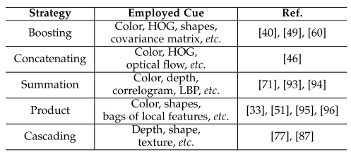
3.1 Appearance Model
Visual representation
RGB
HOG
Others
Statistical measuring
Single cue
Multiple cues

Slide 21
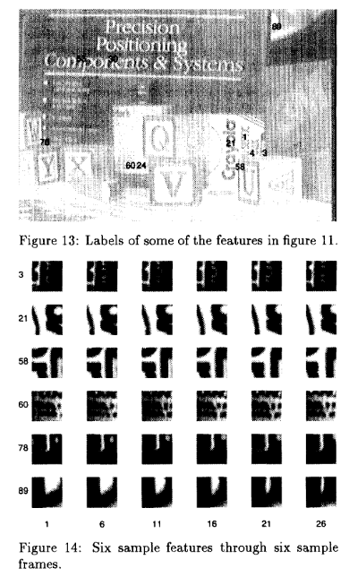
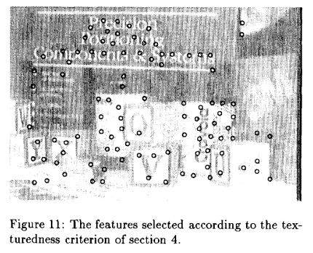
3.1 Appearance Model
Jianbo Shi, & Tomasi. (1994). Good features to track. In Proceedings of IEEE Conference on Computer Vision and Pattern Recognition CVPR-94 (pp. 593–600). IEEE Comput. Soc. Press. https://doi.org/10.1109/CVPR.1994.323794

Slide 22
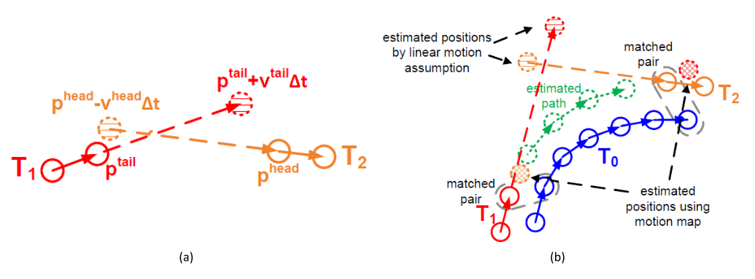
3.2 Motion Model
Linear Motion Model
Non-linear Motion Model

Slide 23
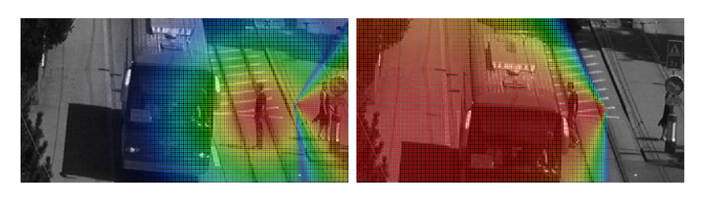
3.2 Motion Model
Detection Confidence Density
Breitenstein, M. D., Reichlin, F., Leibe, B., Koller-Meier, E., & Van Gool, L. (2009). Robust tracking-by-detection using a detector confidence particle filter. Proceedings of the IEEE International Conference on Computer Vision, (Iccv), 1515–1522. https://doi.org/10.1109/ICCV.2009.5459278

Slide 24
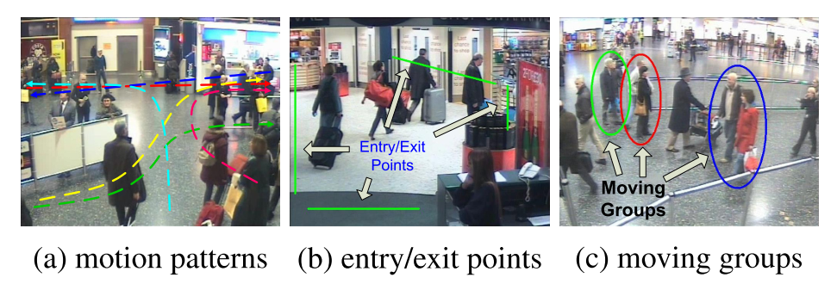
3.2 Motion Model
Yang, B., & Nevatia, R. (2014). Multi-target tracking by online learning a CRF model of appearance and motion patterns. International Journal of Computer Vision, 107(2), 203–217. https://doi.org/10.1007/s11263-013-0666-4

Slide 25
3.3 Interaction Model
Social Force Models
Individual Force
fidelity, which means one should not change his desired destination
constancy, which means one should not suddenly change his momentum, including speed and direction
Group Force
attraction, which means individuals moving together as a group should stay close
repulsion, which means that individuals moving together as a group should keep some distance away from others to make all members comfortable
coherence, which means individuals moving together as
Crowd Motion Pattern Models
`

Slide 26
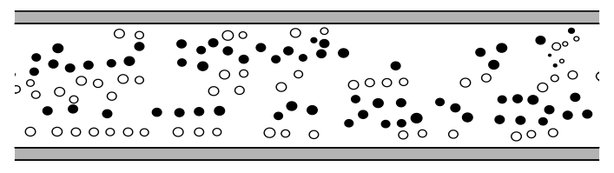
3.3 Interaction Model
The desired velocity of motion
A pedestrian keeps a certain distance to other pedestrians and borders
A term modeling attractive effects
Helbing, D., & Molnár, P. (1995). Social force model for pedestrian dynamics. Physical Review E, 51(5), 4282–4286. https://doi.org/10.1103/PhysRevE.51.4282

Slide 27
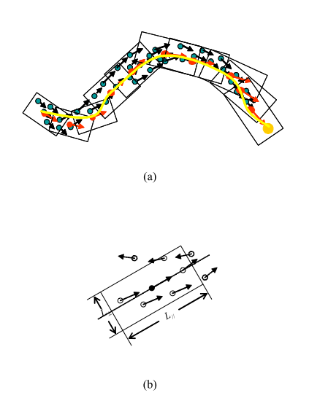
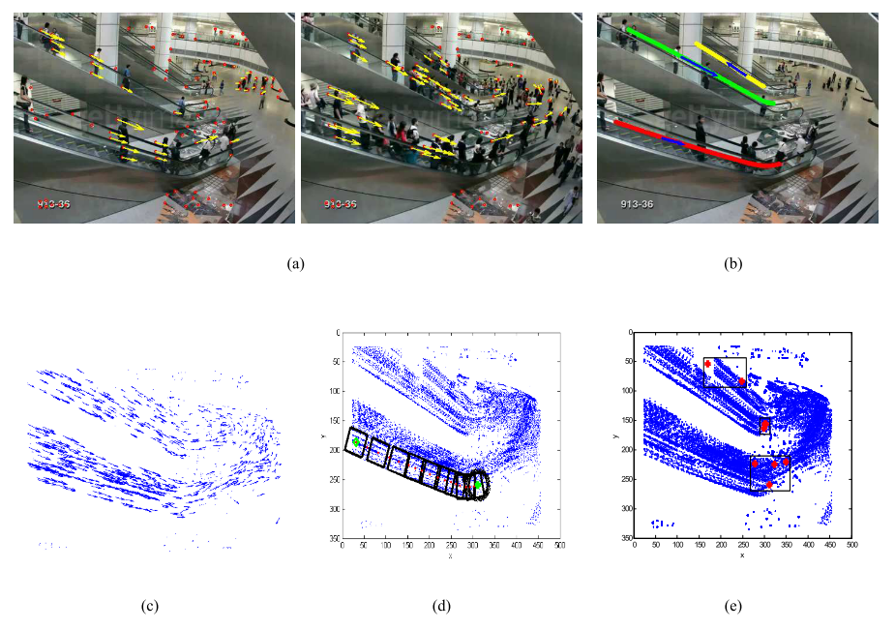
3.3 Interaction Model
Hu, M., Ali, S., & Shah, M. (2009). Detecting global motion patterns in complex videos, 1–5. https://doi.org/10.1109/icpr.2008.4760950

Slide 28
3.4 Exclusion Model
Detection-level Exclusion Model
Soft Modeling
Hard Modeling
Trajectory-level Exclusion Model

Slide 29
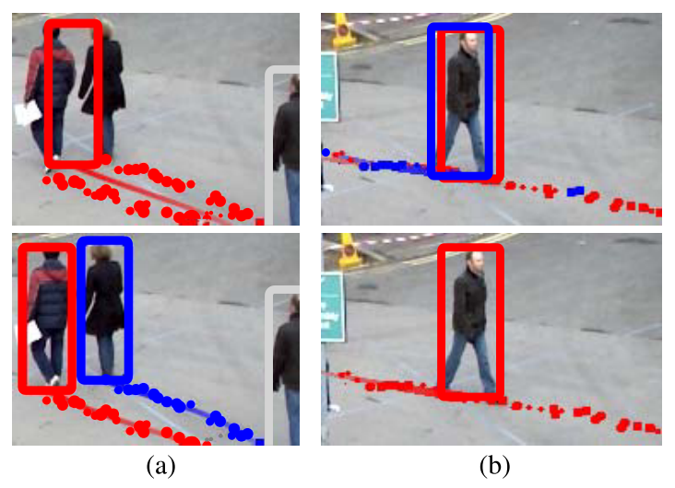
3.4 Exclusion Model
Each target observation should support at most one trajectory and each trajectory should be assigned at most one observation per frame.
Two trajectories should remain spatially separated at all times to avoid collisions.
Milan, A., Schindler, K., & Roth, S. (2013). Detection- and trajectory-level exclusion in multiple object tracking. Proceedings of the IEEE Computer Society Conference on Computer Vision and Pattern Recognition, 3682–3689. https://doi.org/10.1109/CVPR.2013.472

Slide 30
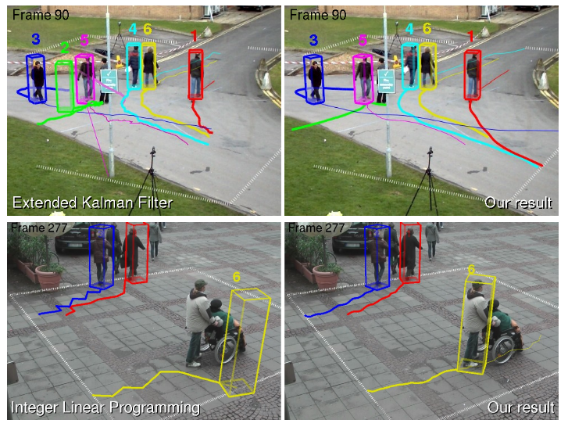
3.4 Exclusion Model
Andriyenko, A., & Schindler, K. (2011). Multi-target tracking by continuous energy minimization. Proceedings of the IEEE Computer Society Conference on Computer Vision and Pattern Recognition, 1265–1272. https://doi.org/10.1109/CVPR.2011.5995311

Slide 31
3.5 Occlusion Handling
Part-to-whole
Hypothesize-and-test
Buffer-and-recover
Others
Others

Slide 32
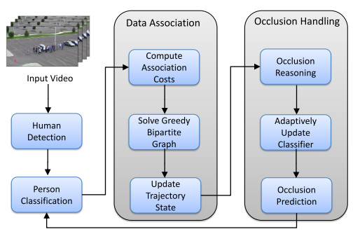
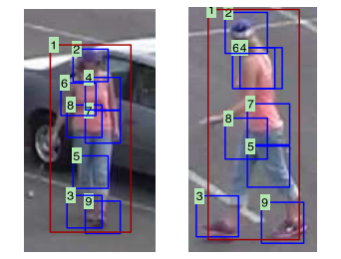
3.5 Occlusion Handling
Shu, G., Dehghan, A., Oreifej, O., Hand, E., & Shah, M. (2012). Part-based multiple-person tracking with partial occlusion handling. Proceedings of the IEEE Computer Society Conference on Computer Vision and Pattern Recognition, 1815–1821. https://doi.org/10.1109/CVPR.2012.6247879

Slide 33
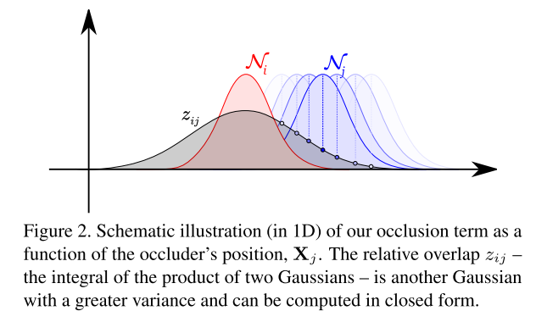
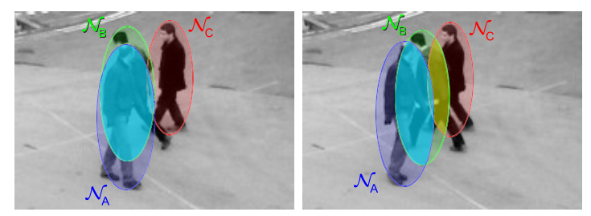
3.5 Occlusion Handling
Andriyenko, A., Roth, S., & Schindler, K. (2011). An analytical formulation of global occlusion reasoning for multi-target tracking. Proceedings of the IEEE International Conference on Computer Vision, (November), 1839–1846. https://doi.org/10.1109/ICCVW.2011.6130472

Slide 34
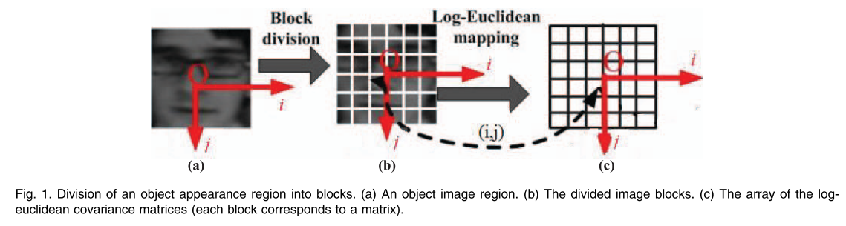
3.5 Occlusion Handling
Hu, W., Li, X., Luo, W., Zhang, X., Maybank, S., & Zhang, Z. (2012). Single and multiple object tracking using log-euclidean riemannian subspace and block-division appearance model. IEEE Transactions on Pattern Analysis and Machine Intelligence, 34(12), 2420–2440. https://doi.org/10.1109/TPAMI.2012.42

Slide 35
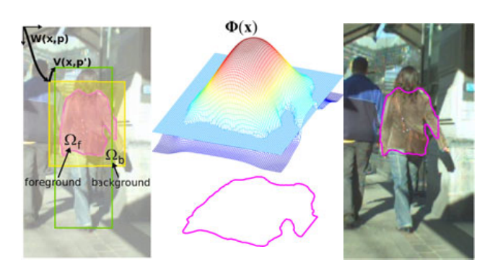
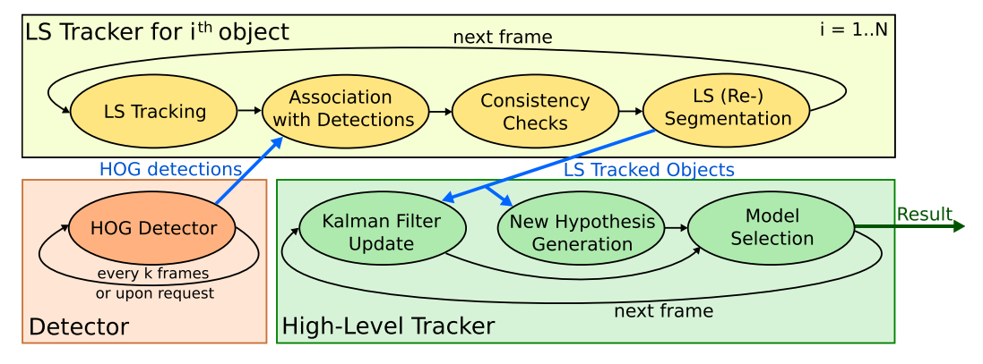
3.5 Occlusion Handling
Mitzel, D., Horbert, E., Ess, A., & Leibe, B. (2010). Multi-person tracking with sparse detection and continuous segmentation. Lecture Notes in Computer Science (Including Subseries Lecture Notes in Artificial Intelligence and Lecture Notes in Bioinformatics), 6311 LNCS(PART 1), 397–410. https://doi.org/10.1007/978-3-642-15549-9_29

Slide 36
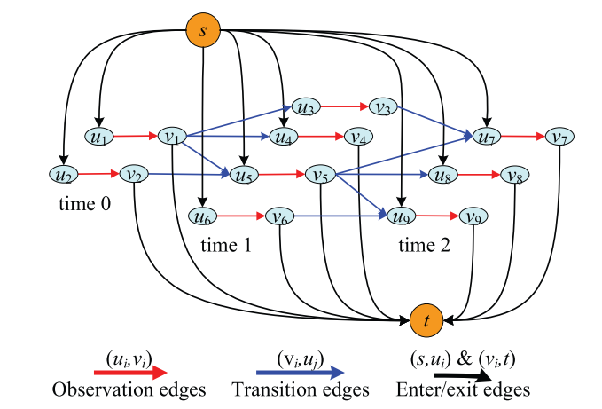
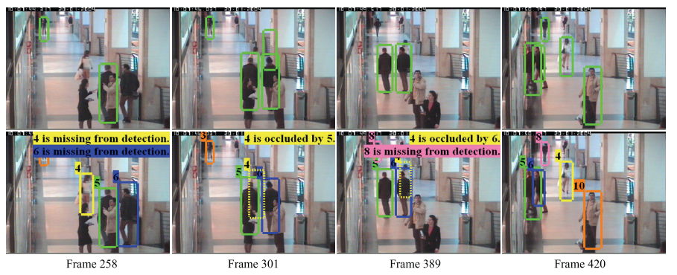
3.5 Occlusion Handling
Zhang, L., Li, Y., & Nevatia, R. (2008). Global data association for multi-object tracking using network flows. 26th IEEE Conference on Computer Vision and Pattern Recognition, CVPR. https://doi.org/10.1109/CVPR.2008.4587584

Slide 37
3.6 Inference
Probabilistic Inference
Deterministic Optimization
Bipartite graph matching
Dynamic Programming
Min-cost max-flow network flow
Conditional random field
MWIS

Slide 38
4
MOT Evaluation

Slide 39
4 MOT Evaluation
Metrics
Datasets

Slide 40
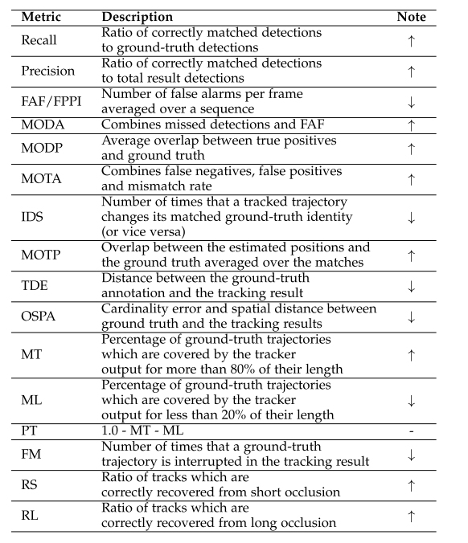
4.1 Metrics
Metrics for Detection
Accuracy
Precision
Metrics for Tracking
Accuracy
Precision
Completeness
Robustness

Slide 41
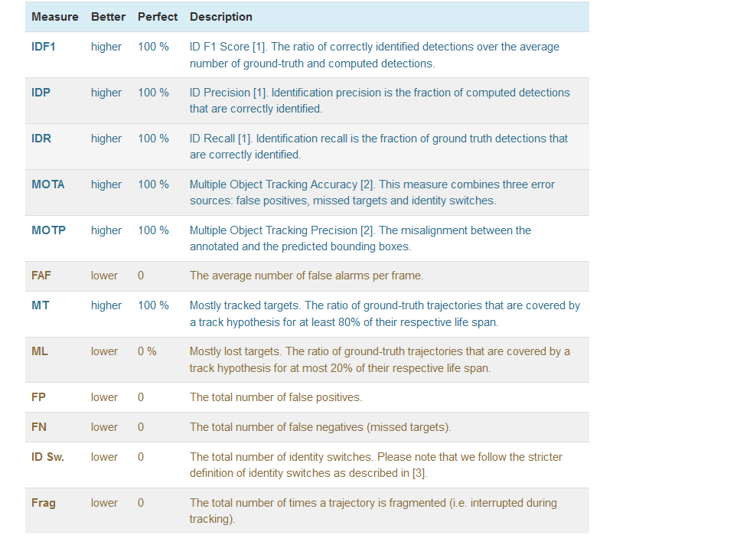
4.1 Metrics
Metrics for Detection
Accuracy
Precision
Metrics for Tracking
Accuracy
Precision
Completeness
Robustness

Slide 42
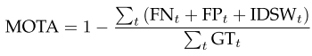
4.1 Metrics
MOTA
Combines three error sources:
False positives, missed targets and identity switches
IDF1
The ratio of correctly identified detections over the average number of ground-truth and computed detections

Slide 43
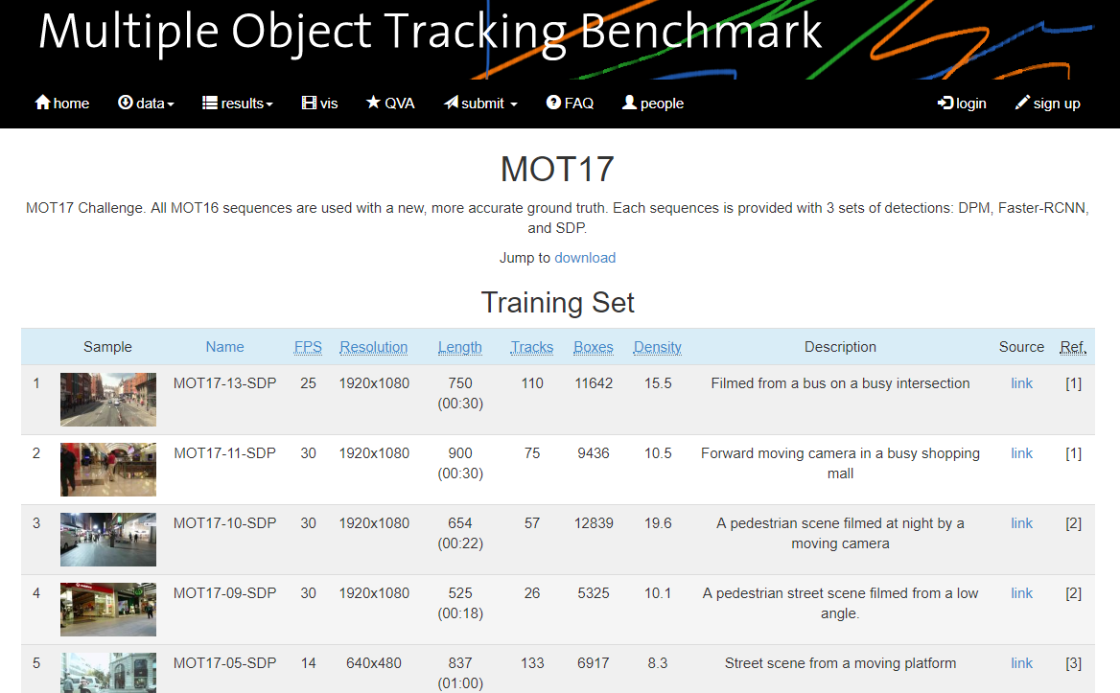
4.2 Datasets
MOT Benchmark (https://motchallenge.net)

Slide 44
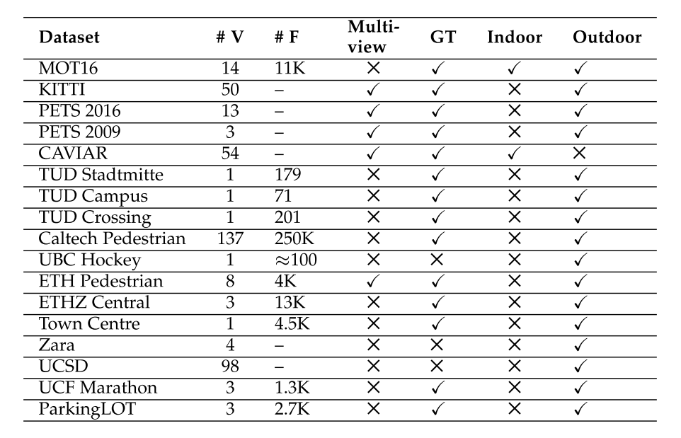
4.2 Datasets

Slide 45
4.2 Datasets
PETS09-S2L1：该视频主要挑战在于目标移动在高速非线性模式下，目标遮挡频繁。
PETS09-S2L2：存在严重遮挡。
TUD-Stadtmitte：视角低，相互遮挡严重，出现完全遮挡
ParkingLot：相互遮挡比TUD还要严重
TownCenter：16个人形随时可见导致了频繁遮挡，由于静态背景中存在沙滩导致部分目标不能被检测出。

Slide 46
5
State-of-the-art Works

Slide 47
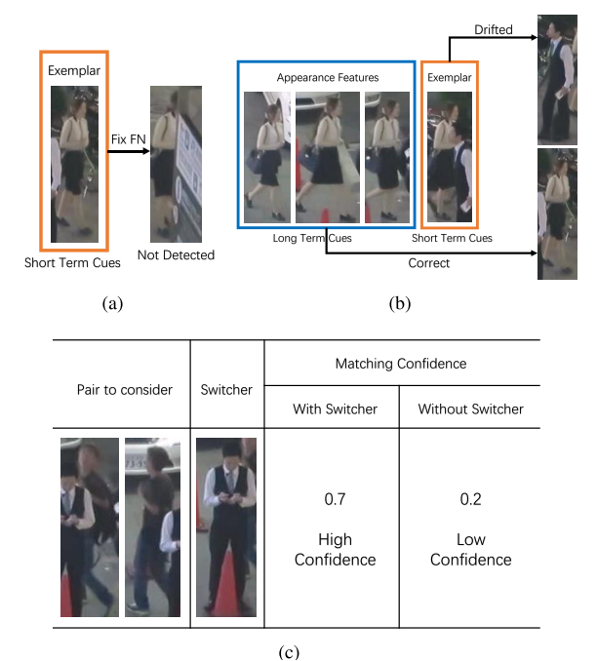
MC&SAC
Feng, W., Hu, Z., Wu, W., Yan, J., & Ouyang, W. (2019). Multi-Object Tracking with Multiple Cues and Switcher-Aware Classification. Retrieved from http://arxiv.org/abs/1901.06129

Slide 48
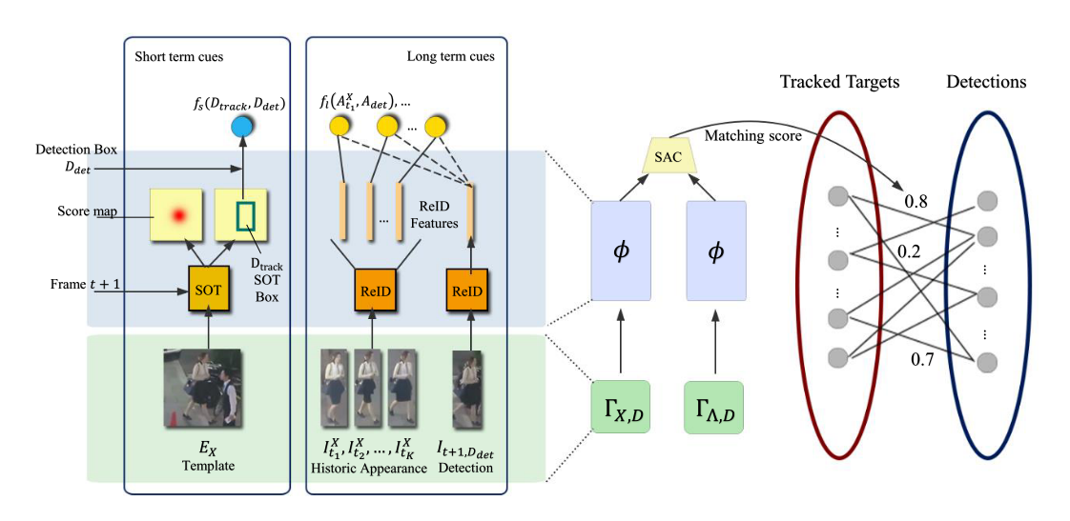
MC&SAC
Feng, W., Hu, Z., Wu, W., Yan, J., & Ouyang, W. (2019). Multi-Object Tracking with Multiple Cues and Switcher-Aware Classification. Retrieved from http://arxiv.org/abs/1901.06129

Slide 49
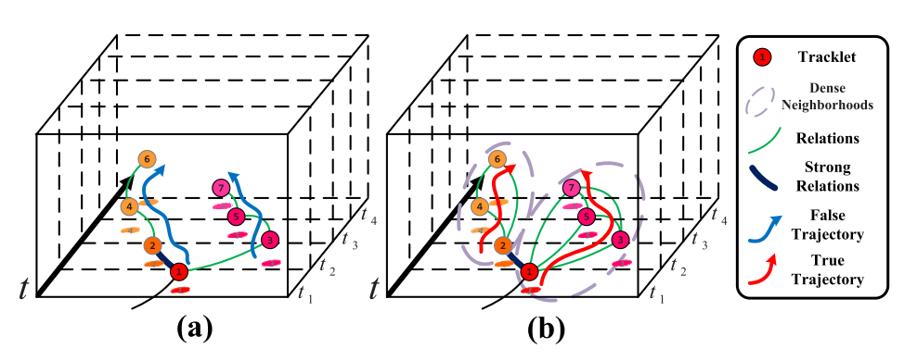
H2T
Wen, L., Li, W., Yan, J., Lei, Z., Yi, D., & Li, S. Z. (2014). Multiple target tracking based on undirected hierarchical relation hypergraph. Proceedings of the IEEE Computer Society Conference on Computer Vision and Pattern Recognition, 1282–1289. https://doi.org/10.1109/CVPR.2014.167

Slide 50
POI
state-of-the-art detection
state-of-the-art feature
Kong, X., Xin, B., Wang, Y., & Hua, G. (2017). Collaborative deep reinforcement learning for joint object search. Proceedings - 30th IEEE Conference on Computer Vision and Pattern Recognition, CVPR 2017, 2017–Janua, 7072–7081. https://doi.org/10.1109/CVPR.2017.748

Slide 51
SORT&DeepSORT
State-of-the-art detection
Hungarian Algorithm
Deep association metric
Terms, I., & Tracking, I. (n.d.). REAL-TIME MULTIPLE PEOPLE TRACKING WITH DEEPLY LEARNED CANDIDATE SELECTION AND PERSON RE-IDENTIFICATION Long.

Slide 52
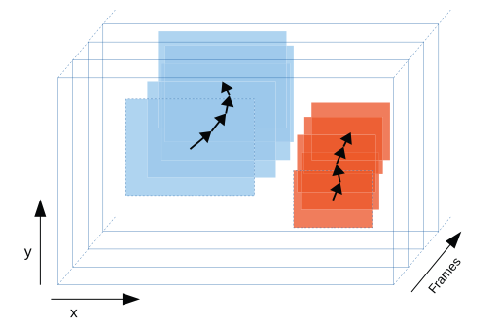
IOU Tracker
Bochinski, E., Eiselein, V., & Sikora, T. (2017). High-Speed tracking-by-detection without using image information. 2017 14th IEEE International Conference on Advanced Video and Signal Based Surveillance, AVSS 2017, (August). https://doi.org/10.1109/AVSS.2017.8078516

Slide 53
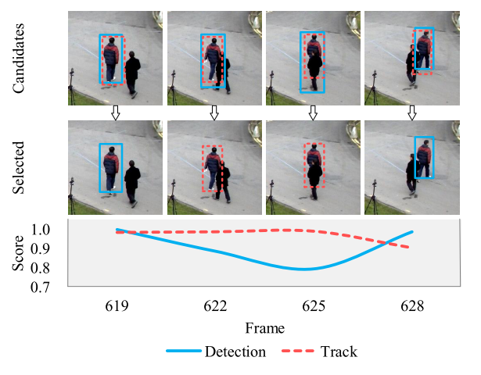
MOTDT
Terms, I., & Tracking, I. (n.d.). REAL-TIME MULTIPLE PEOPLE TRACKING WITH DEEPLY LEARNED CANDIDATE SELECTION AND PERSON RE-IDENTIFICATION Long.

Slide 54
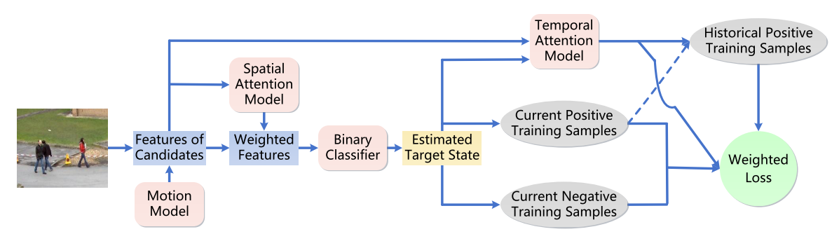
STAM
Chu, Q., Ouyang, W., Li, H., Wang, X., Liu, B., & Yu, N. (2017). Online Multi-object Tracking Using CNN-Based Single Object Tracker with Spatial-Temporal Attention Mechanism. Proceedings of the IEEE International Conference on Computer Vision, 2017–Octob, 4846–4855. https://doi.org/10.1109/ICCV.2017.518

Slide 55
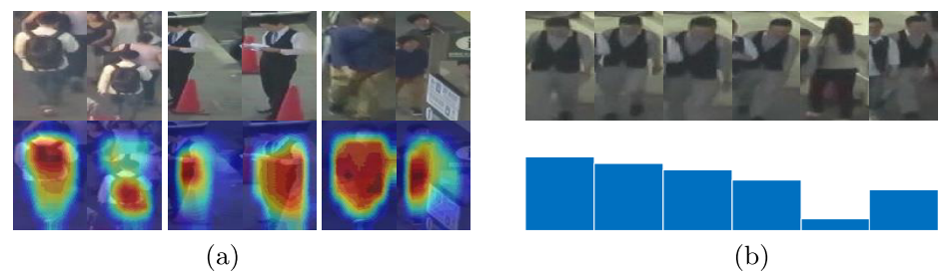
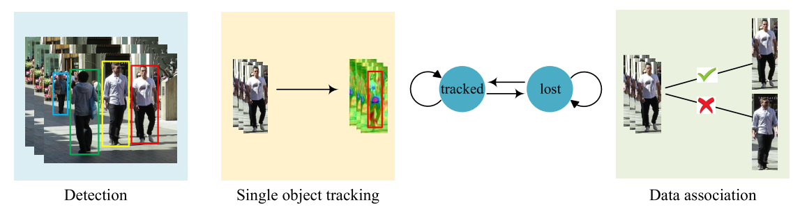
Online MOT -- DMAN
Zhu, J., Yang, H., Liu, N., Kim, M., Zhang, W., & Yang, M. H. (2018). Online Multi-Object Tracking with Dual Matching Attention Networks. Lecture Notes in Computer Science (Including Subseries Lecture Notes in Artificial Intelligence and Lecture Notes in Bioinformatics), 11209 LNCS, 379–396. https://doi.org/10.1007/978-3-030-01228-1_23

Slide 56
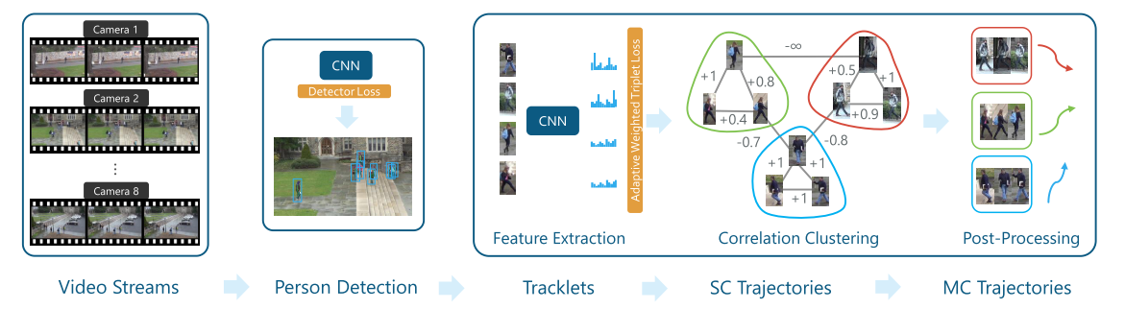
MTMCT -- DeepCC
Ristani, E., & Tomasi, C. (2018). Features for Multi-Target Multi-Camera Tracking and Re-Identification. https://doi.org/10.1109/CVPR.2018.00632

Slide 57
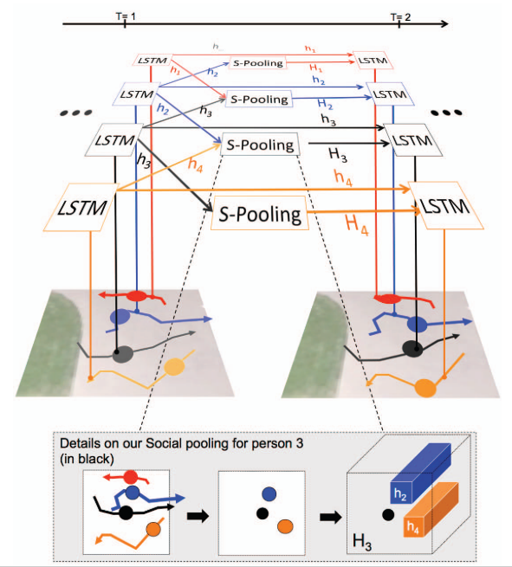
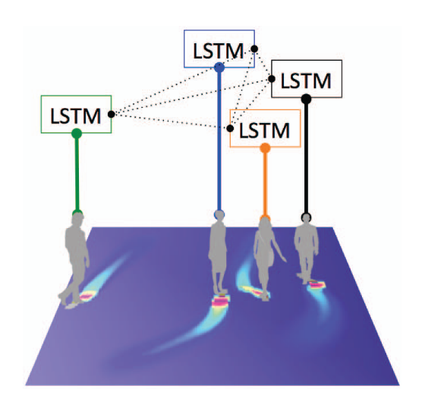
Trajectory Prediction -- Social LSTM
Goel, K., Fei-Fei, L., Savarese, S., Alahi, A., Robicquet, A., & Ramanathan, V. (2016). Social LSTM: Human Trajectory Prediction in Crowded Spaces. 2016 IEEE Conference on Computer Vision and Pattern Recognition (CVPR), 961–971. https://doi.org/10.1109/cvpr.2016.110

Slide 58
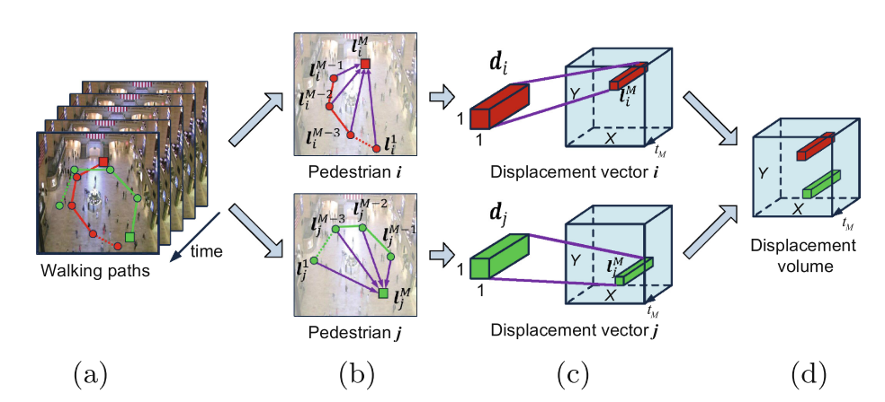
Scene Modeling -- Behavior CNN
Rohrbach, A., Rohrbach, M., Hu, R., Darrell, T., & Schiele, B. (2015). Pedestrian Behavior Understanding and Prediction with Deep Neural Networks. 1511.03745V1, 9905(c), 1–10. https://doi.org/10.1007/978-3-319-46448-0_49

Slide 59
一些自己的想法
Tracking-by-Detection模式是否可以做的更好？
拆解Detection阶段，融入整体框架
深度学习方法如何能更好地运用？
深度特征/单目标跟踪成果
怎么更好处理目标产生和目标离开的情况？
暂时没有想法
如何利用无监督信息？
论文阅读量较少

Slide 60
THANKS

